Slide 1

Management Summary
Facts & figures of Formnext
19 – 22 Nov 2024
FRANKFURT / GERMANY
Honorary sponsor

Slide 2
Hub for Additive Manufacturing
365 days of AM content a year, formnext.com/industryinsights
Partner of the industry all year round
Information hub including
AM Directory
Formnext Magazine
AM4U newsletter
Newsroom
Formnext.TV
AM Field Guide (technology guide)
AM Jobs
19 – 22 November 2024, Frankfurt, Germany
Largest global exhibition dedicated to
Additive Manufacturing / industrial 3D Printing
> 850 exhibitors present their products from the entire process chain
> 32,000 production managers of all manufacturing industries are visitors of Formnext
Expo & Convention
Industry Insights

Slide 3
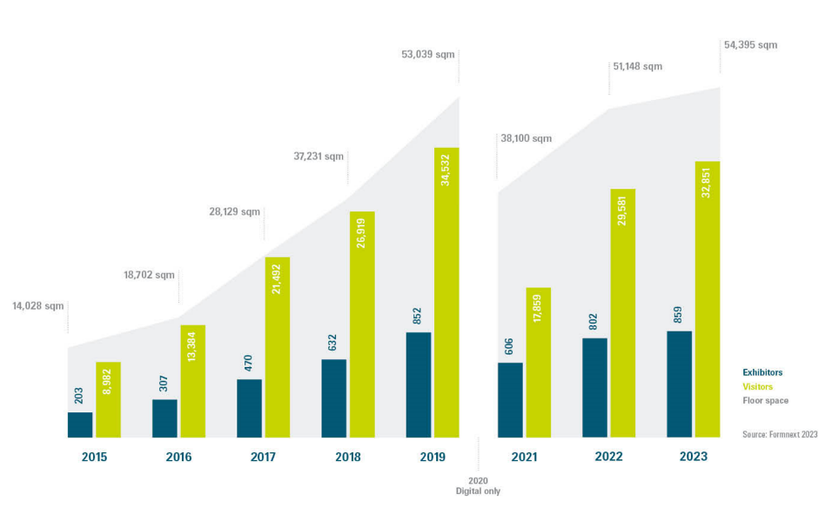
Growth of Formnext

Slide 4
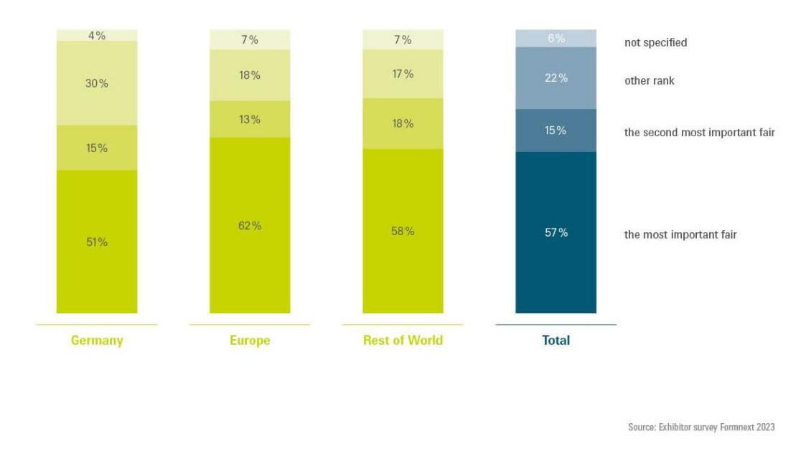
Ranking in international trade fair comparison

Slide 5
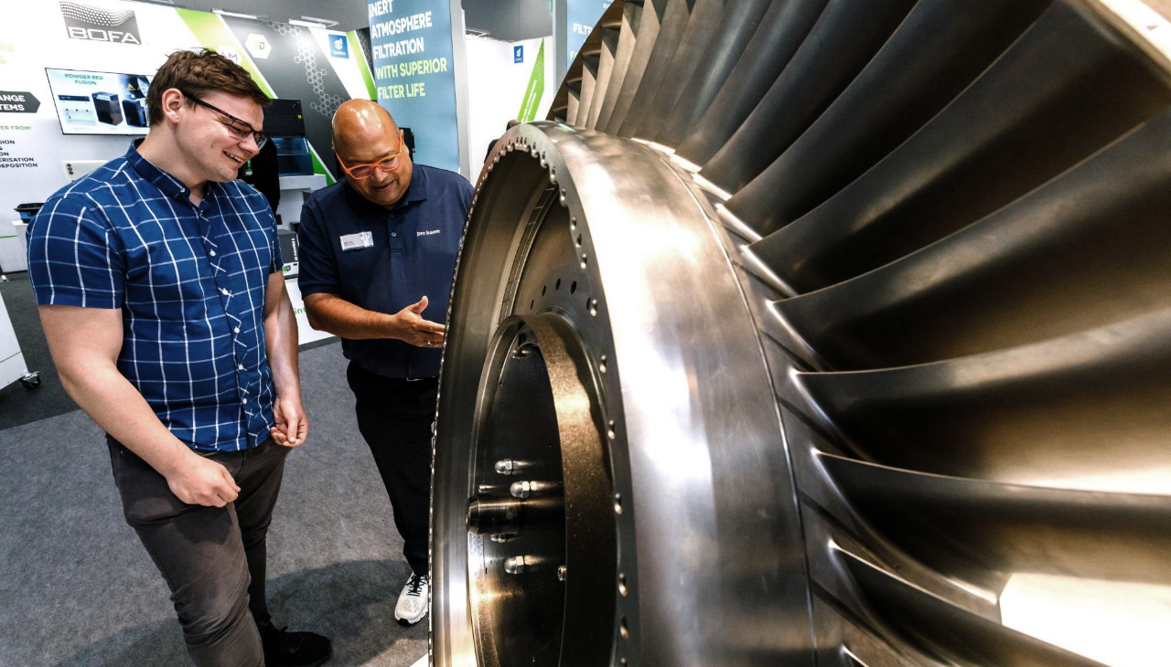
of exhibitors are satisfied to very satisfied with their participation at Formnext.
91
%
Source: Exhibitor survey Formnext 2023

Slide 6
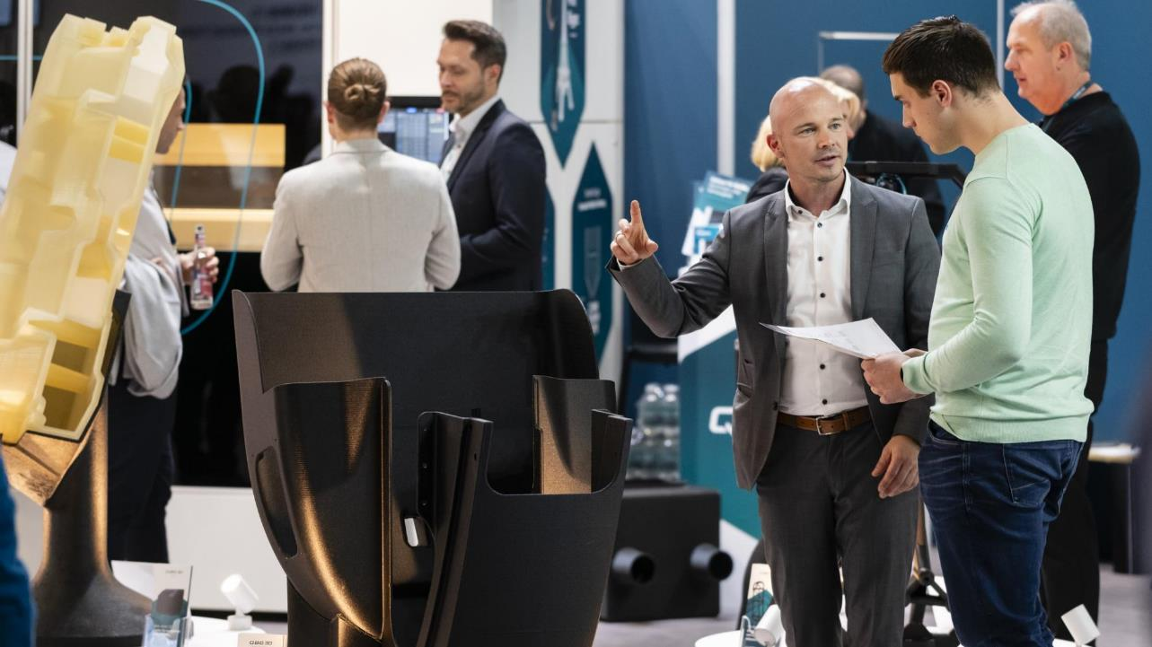
of visitors are satisfied to very satisfied with their attendance at Formnext.
96
%
Source: Visitor survey Formnext 2023

Slide 7
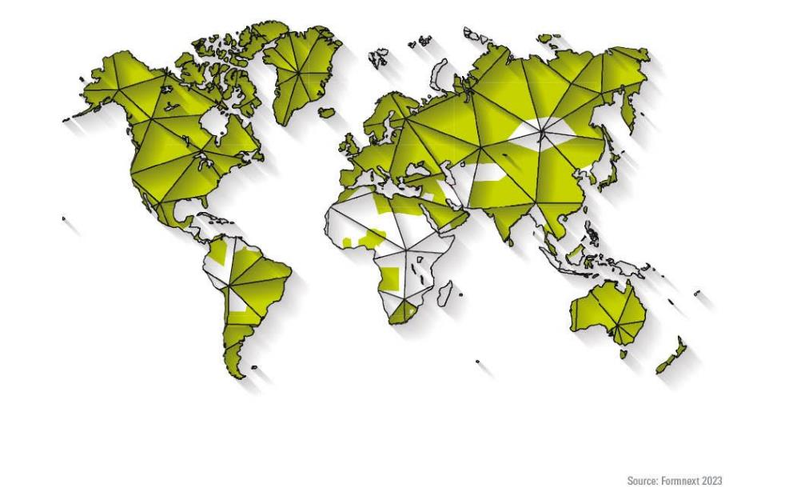
Origin of visitors – by countries

Slide 8
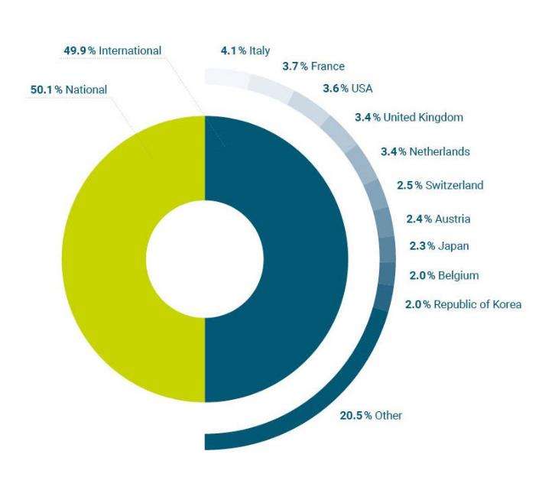
Origin of visitors – top ten nations
Source: Formnext 2023

Slide 9
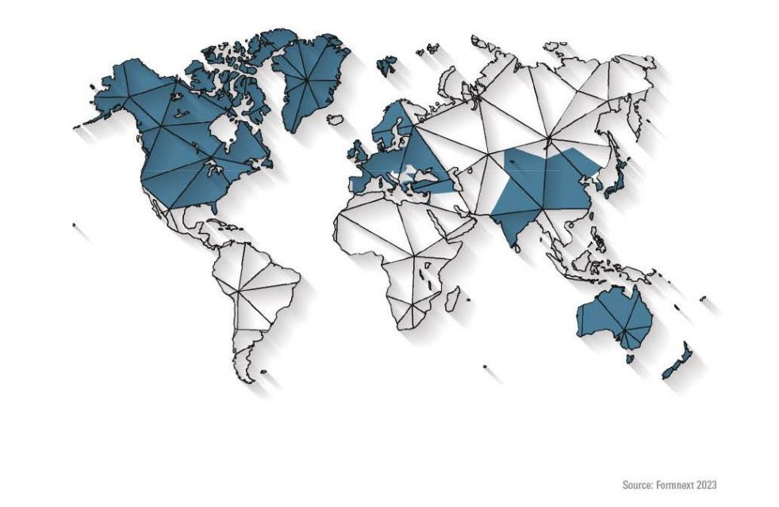
Origin of exhibitors – by country

Slide 10
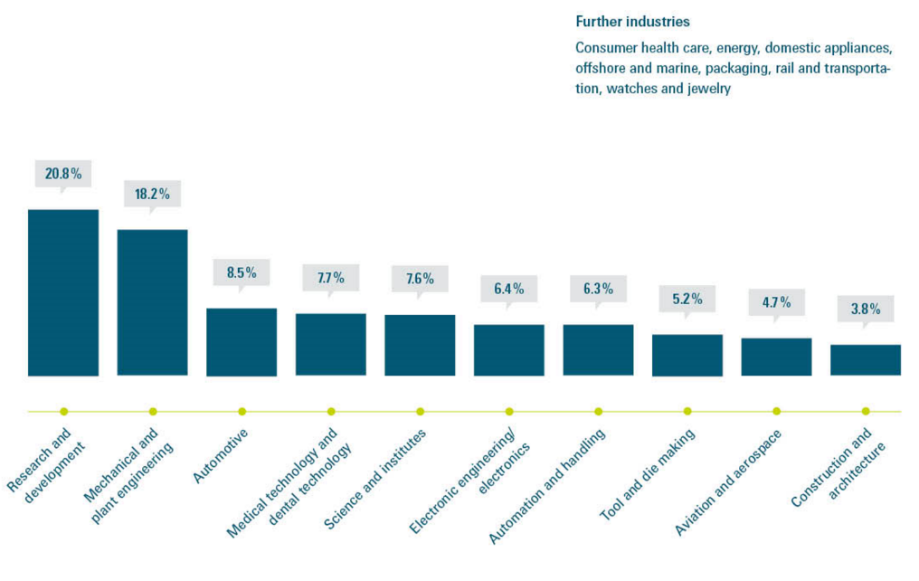
Top 10
user industries
Source: Formnext 2023

Slide 11
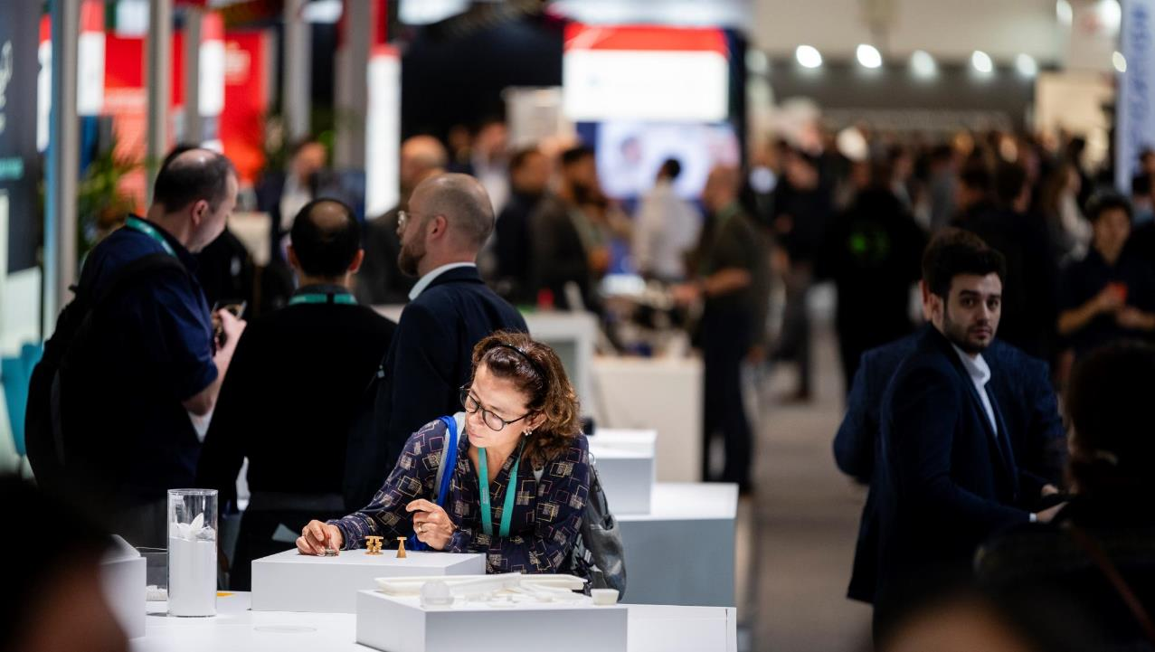
of visitors are satisfied to very satisfied with the achievement of exhibition visit objectives.
Source: Visitor survey
Formnext 2023
97
%

Slide 12
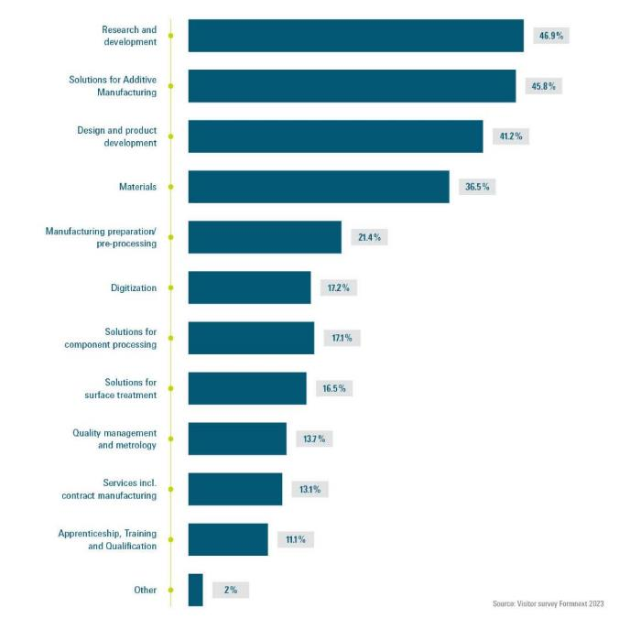
Visitor interest in portfolio
93-95%
Satisfaction rate of visitors with the range of exhibits, innovations and brand presence

Slide 13
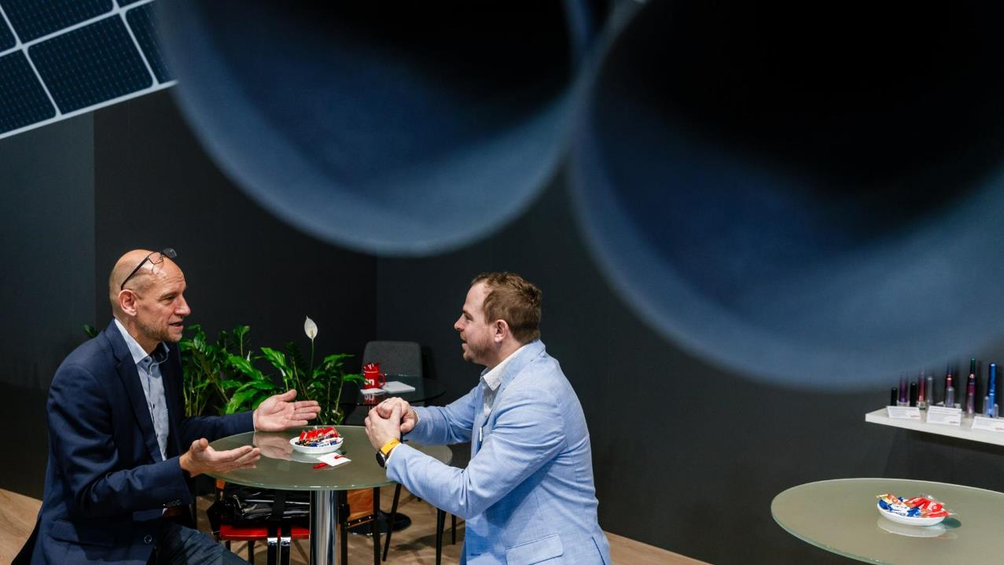
of visitors are decision-makers.
Source: Visitor survey
Formnext 2023
63
%

Slide 14
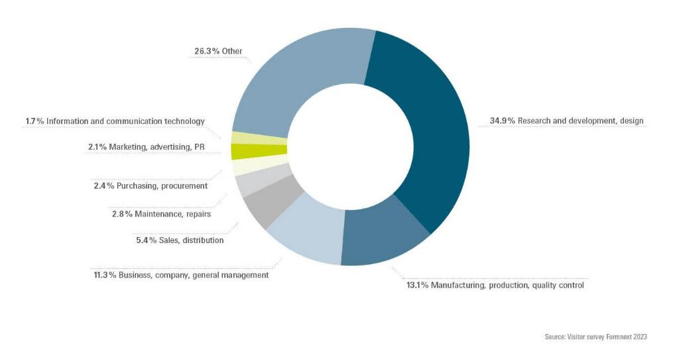
Field of responsibility within the company

Slide 15
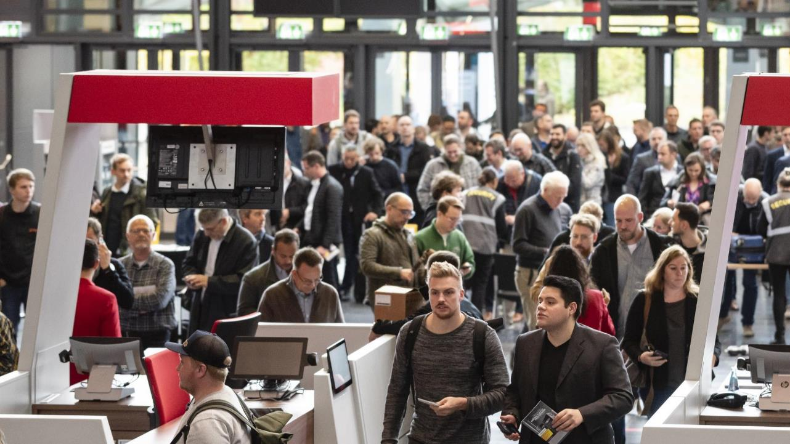
of visitors intend to return.
90
%
Source: Visitor survey Formnext 2023

Slide 16
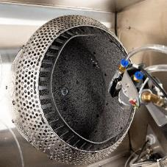

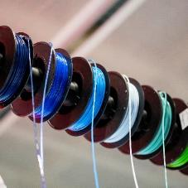
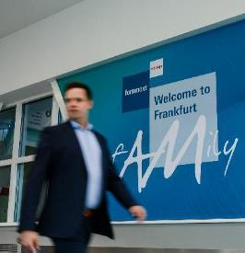
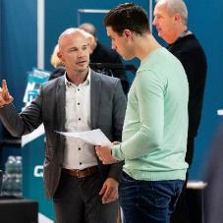
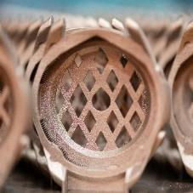
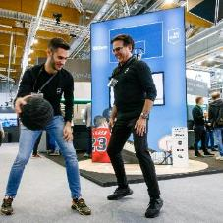
Any questions?
Contact us:
Annabell Grasse annabell.grasse@mesago.com
+49 711 61946 141

Slide 17
